Slide 1

AIRFLOW
https://airflow.apache.org/
> Mayur Jain
( mayurjain333@gmail.com , 9643171490 )

Slide 2
STEP 1. Installation Guide With Some Examples… Let’s Dig In

Slide 3
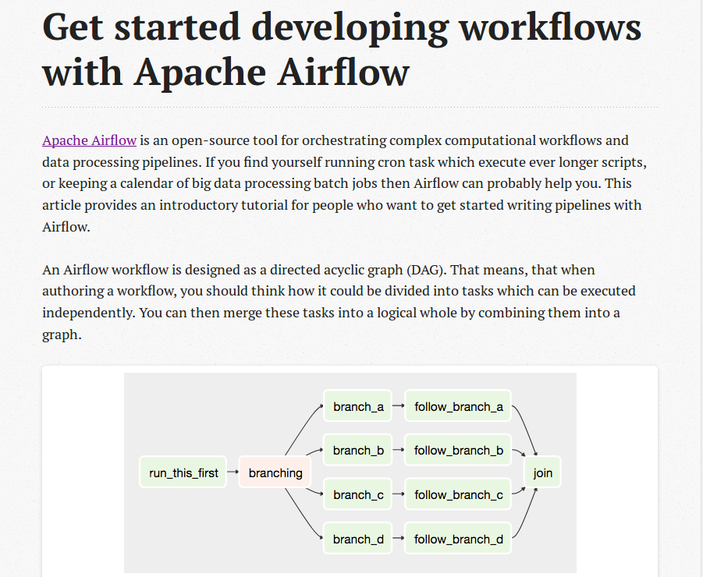

Slide 4
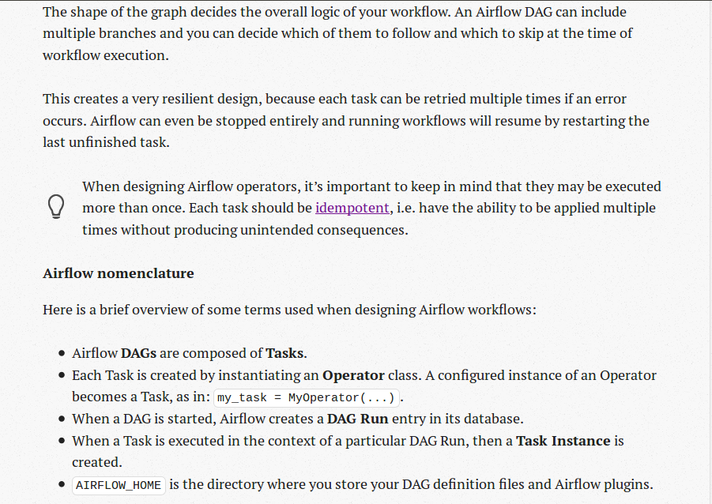

Slide 5
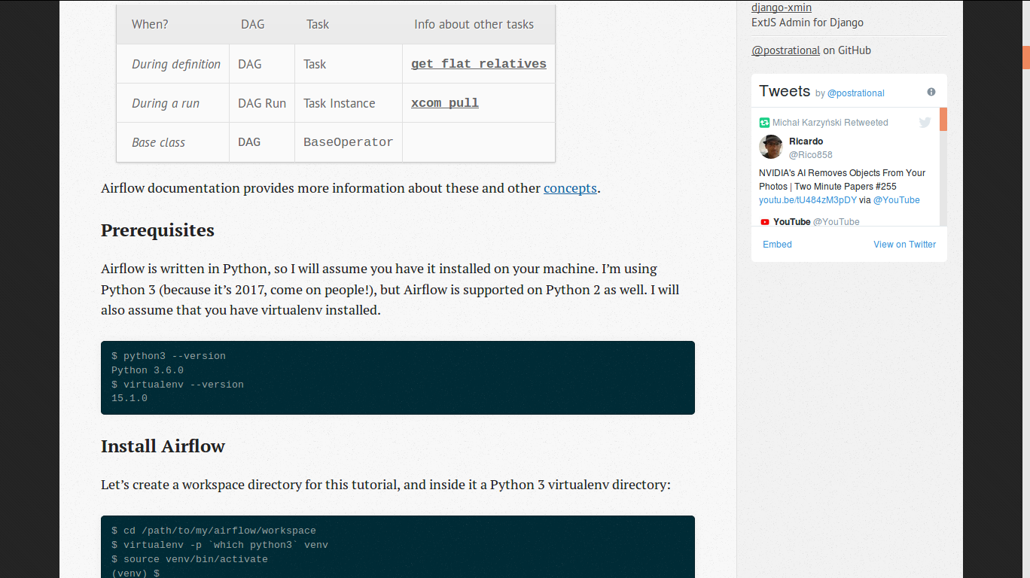

Slide 6
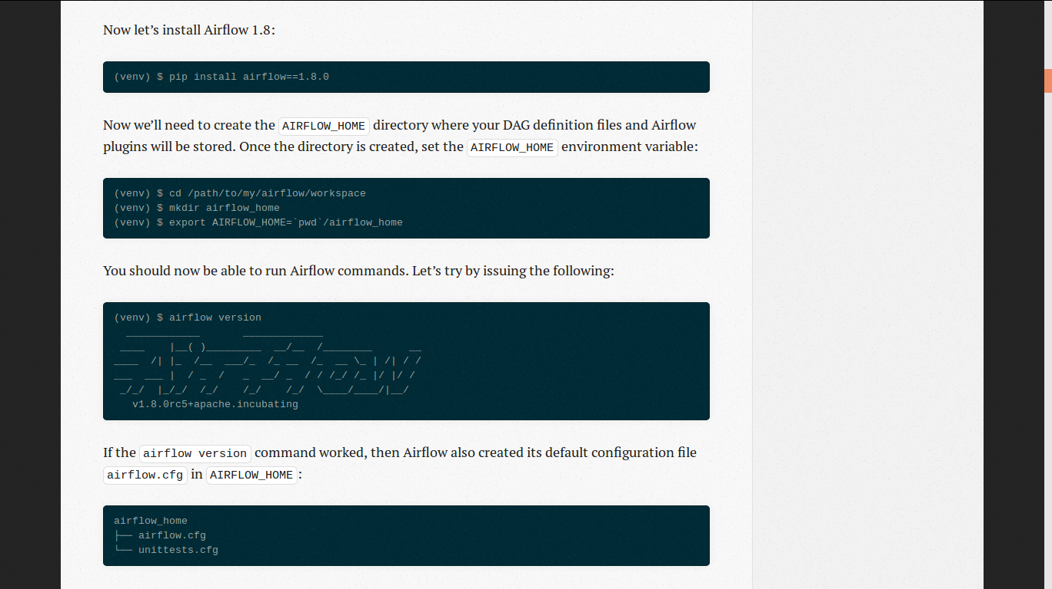

Slide 7
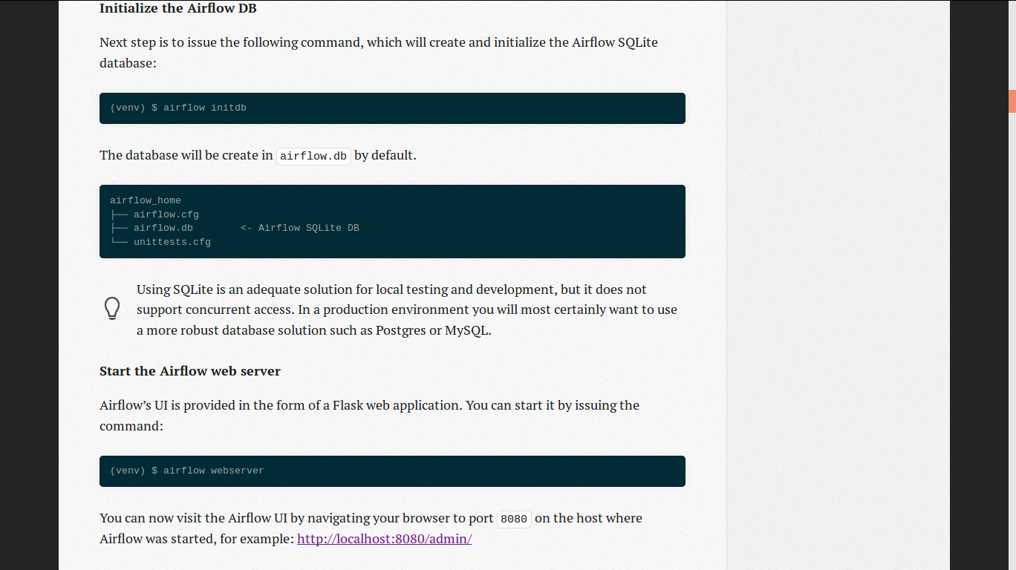

Slide 8
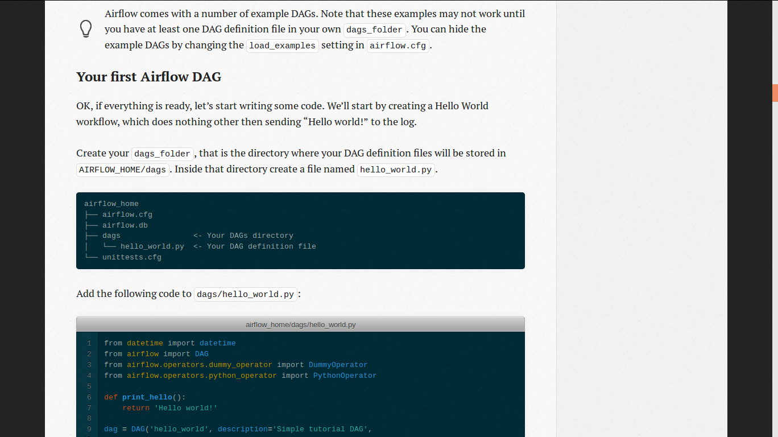

Slide 9
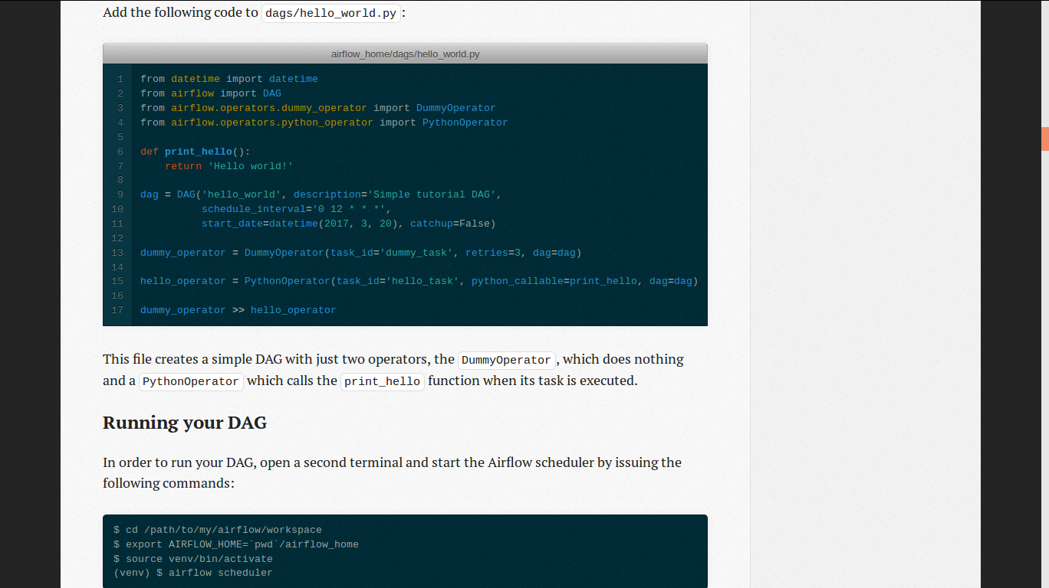

Slide 10
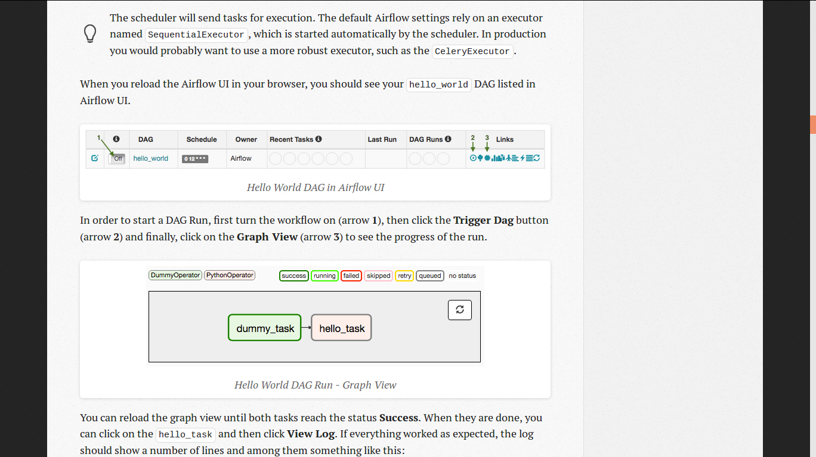

Slide 11
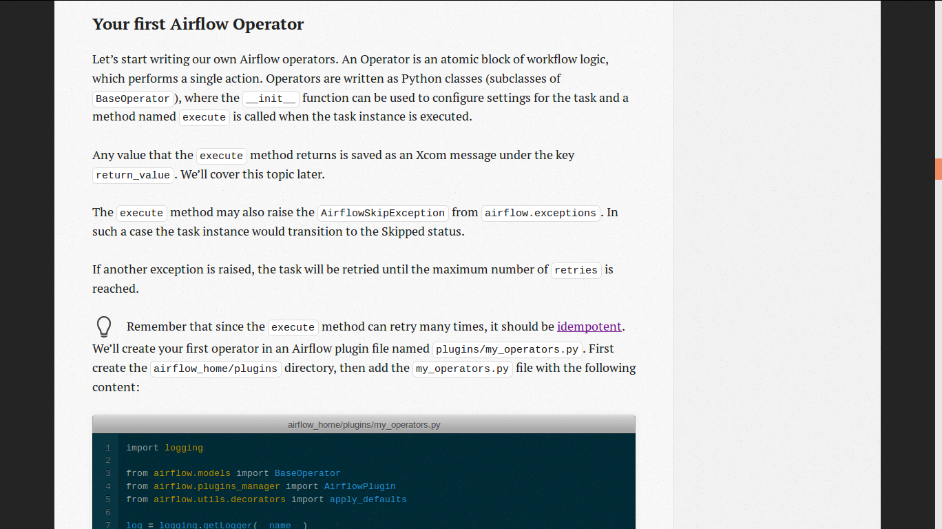

Slide 12
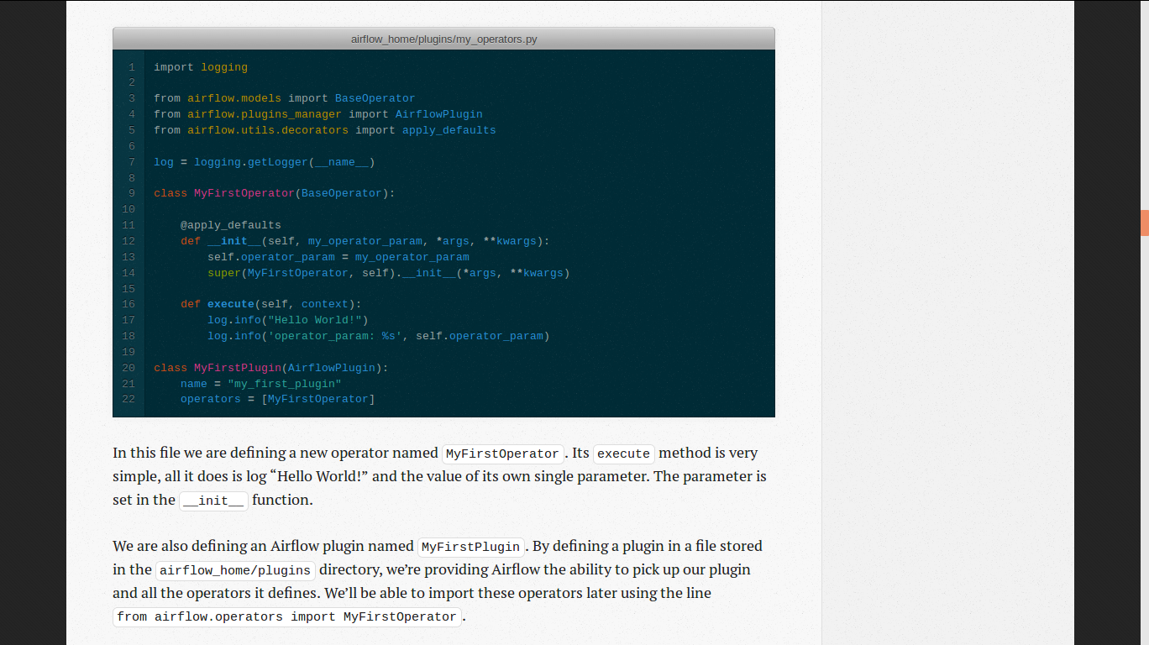

Slide 13
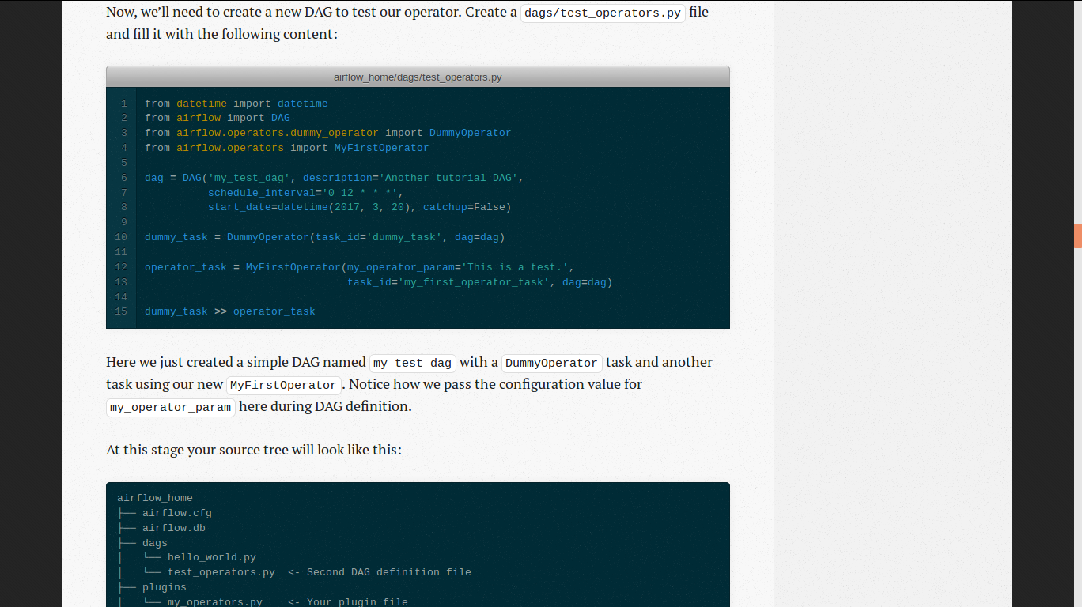

Slide 14
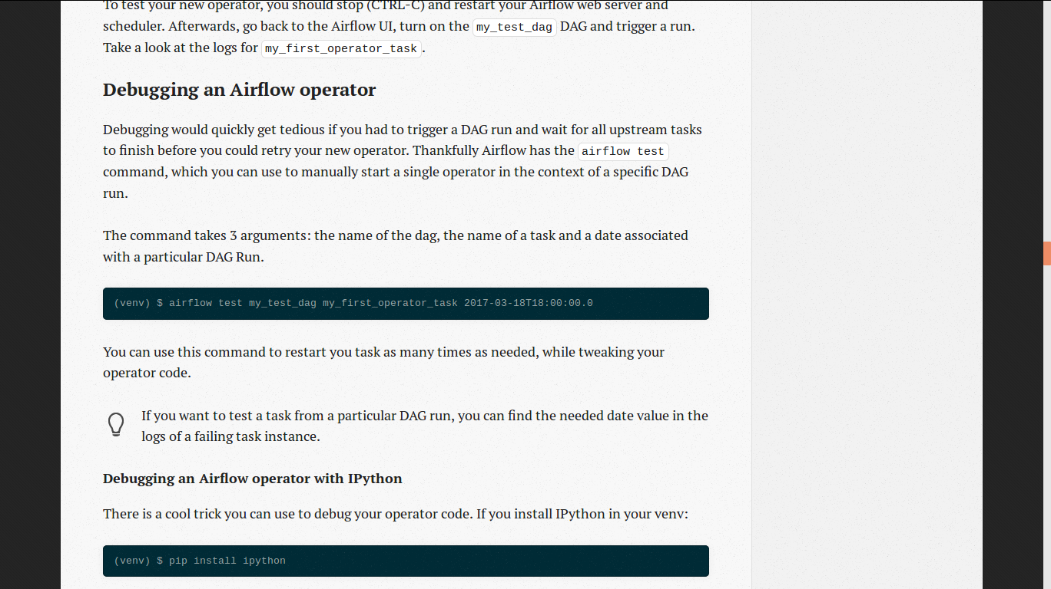

Slide 15
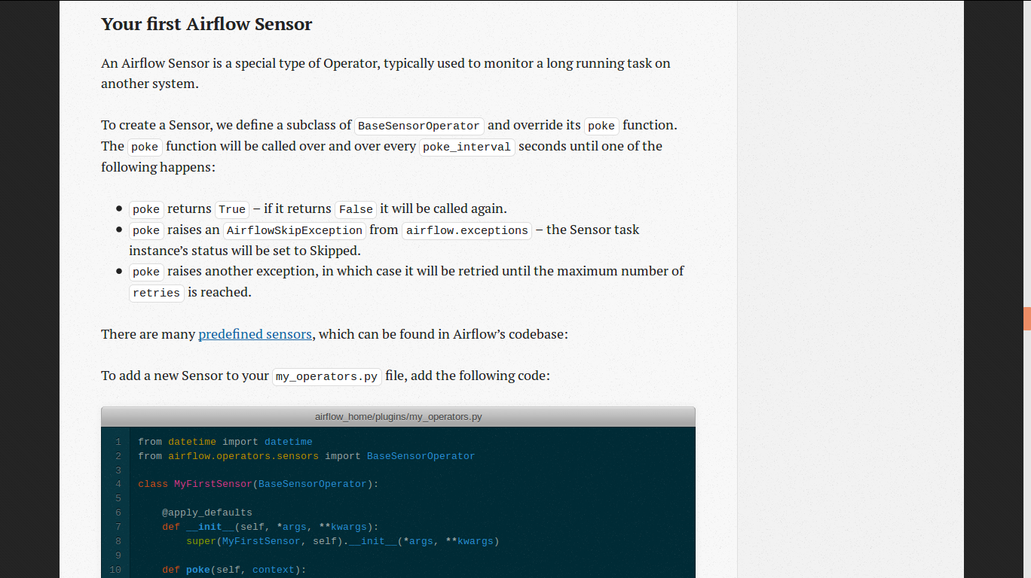

Slide 16
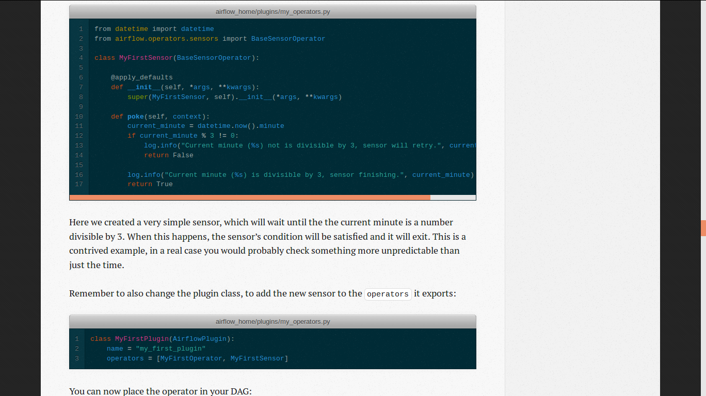

Slide 17
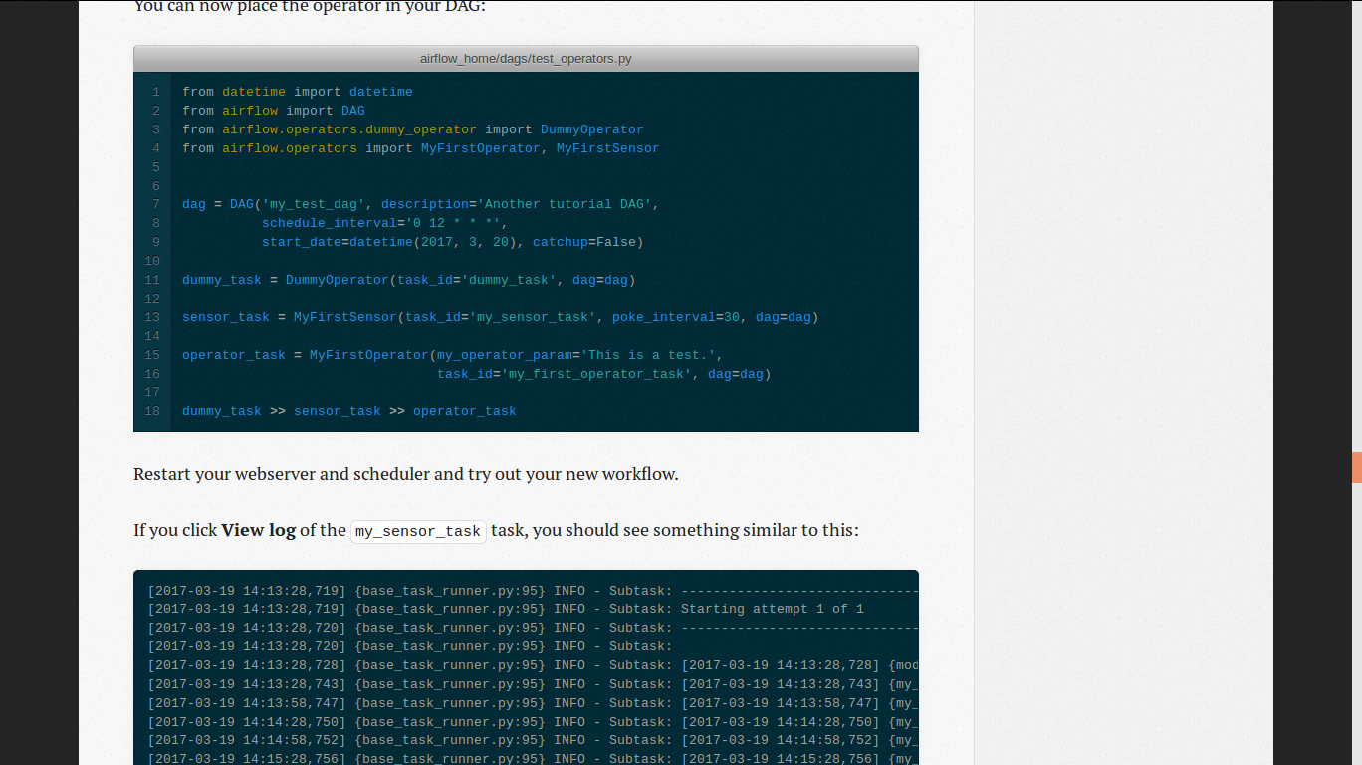

Slide 18
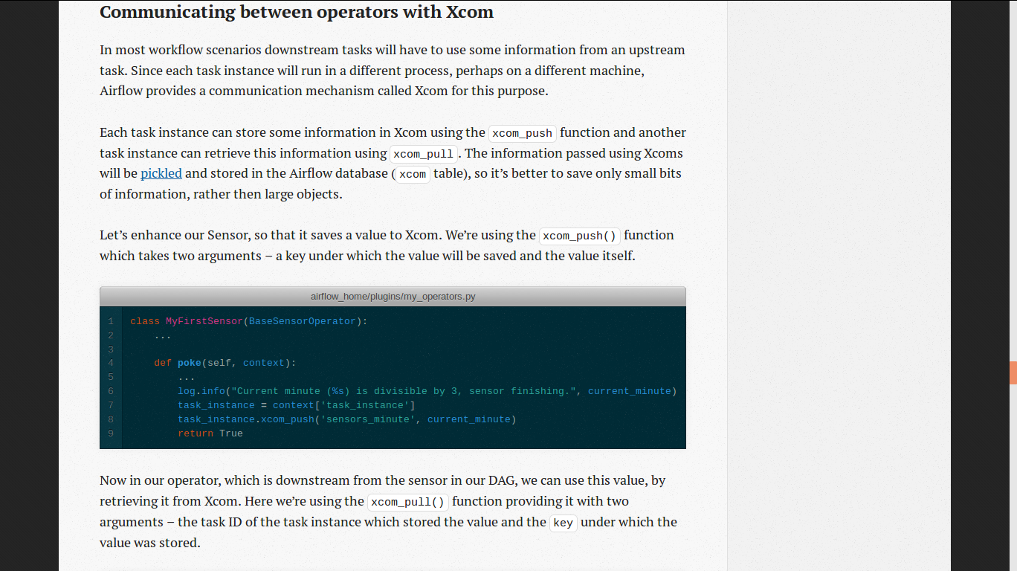

Slide 19
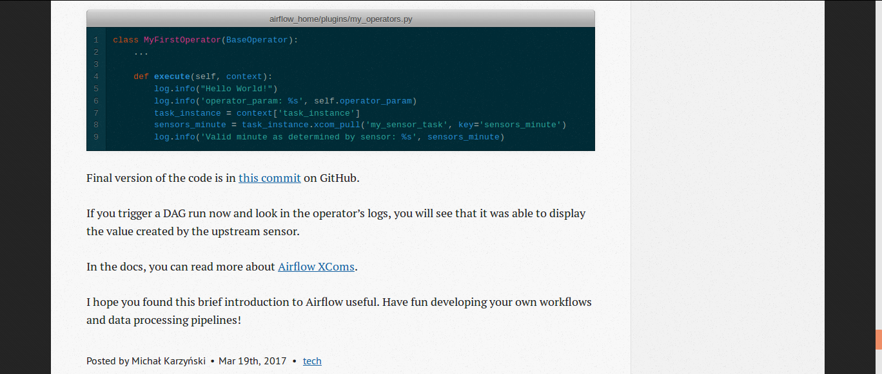

Slide 20

STEP 2. Project Based Learning
Part A
Coding In Python Language

Slide 21
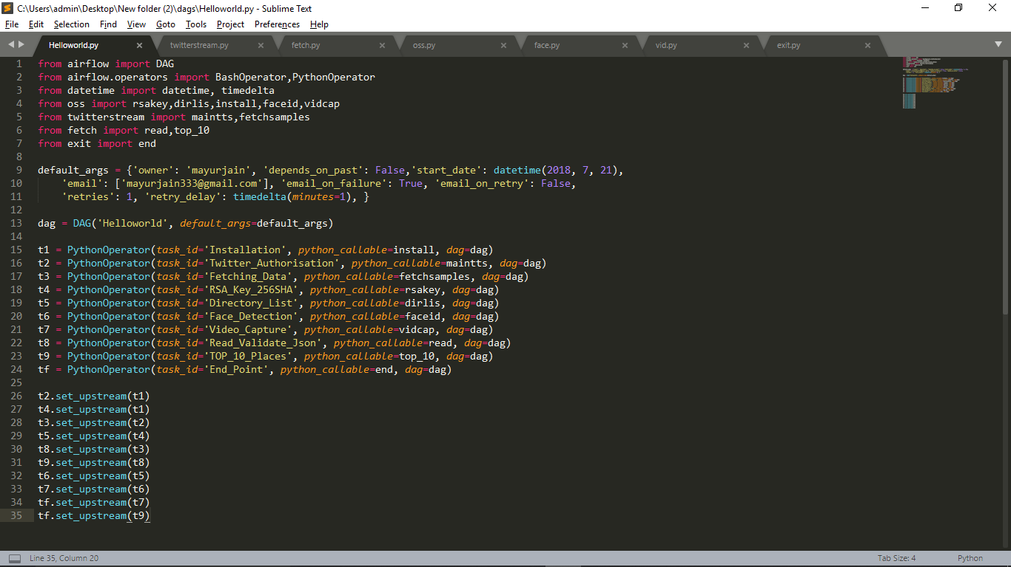

Slide 22
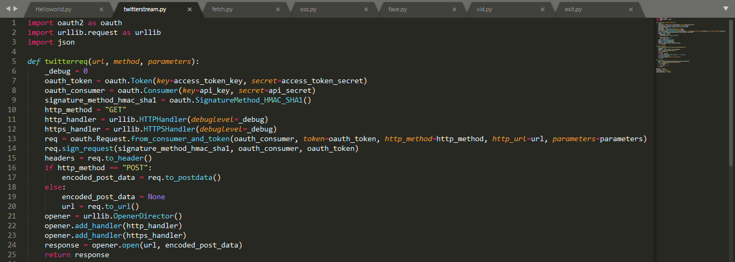

Slide 23
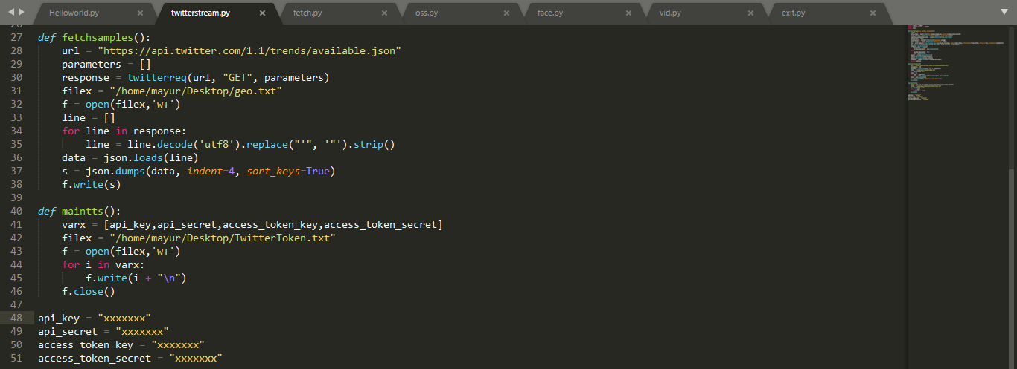
You Have To Enter The API Keys Here…

Slide 24
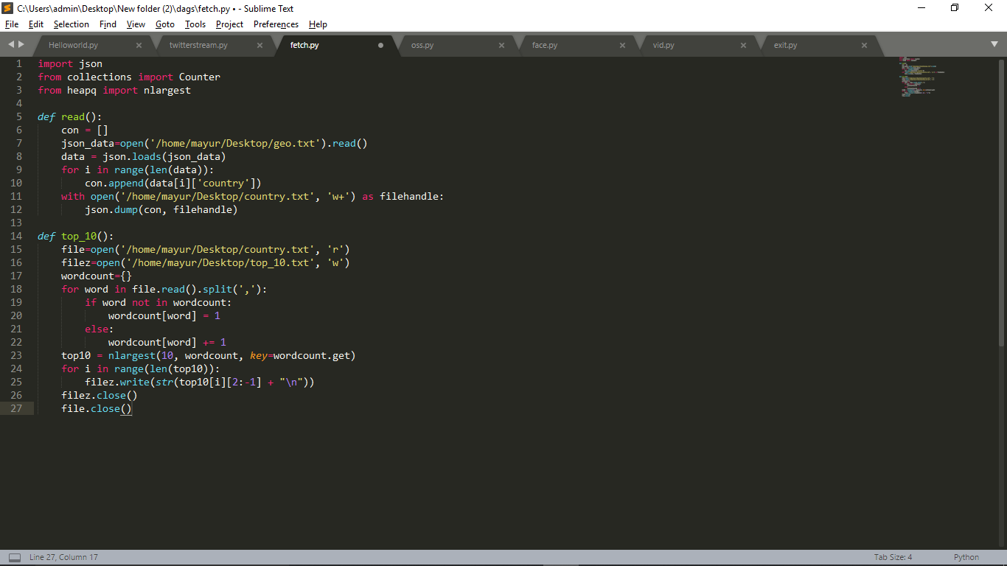
Enter Your File Path Here…

Slide 25
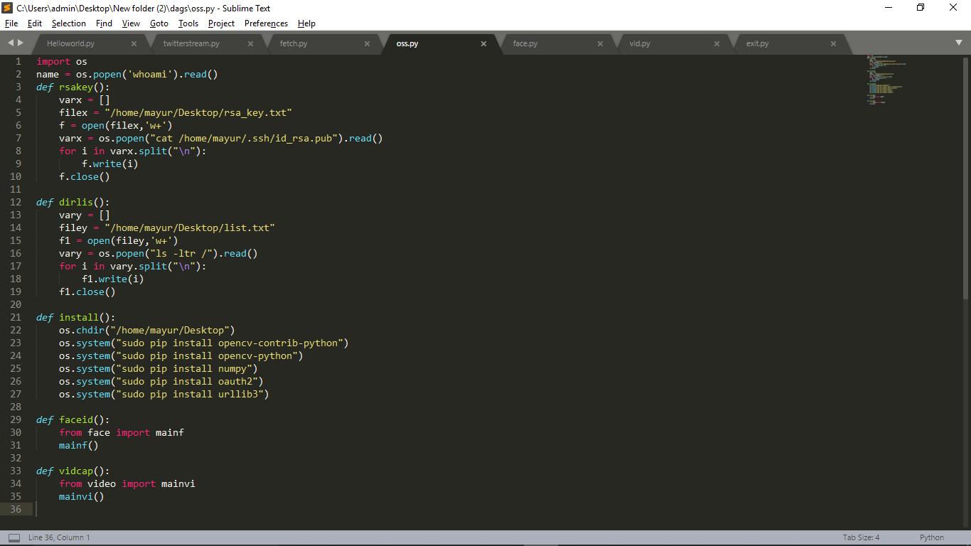

Slide 26
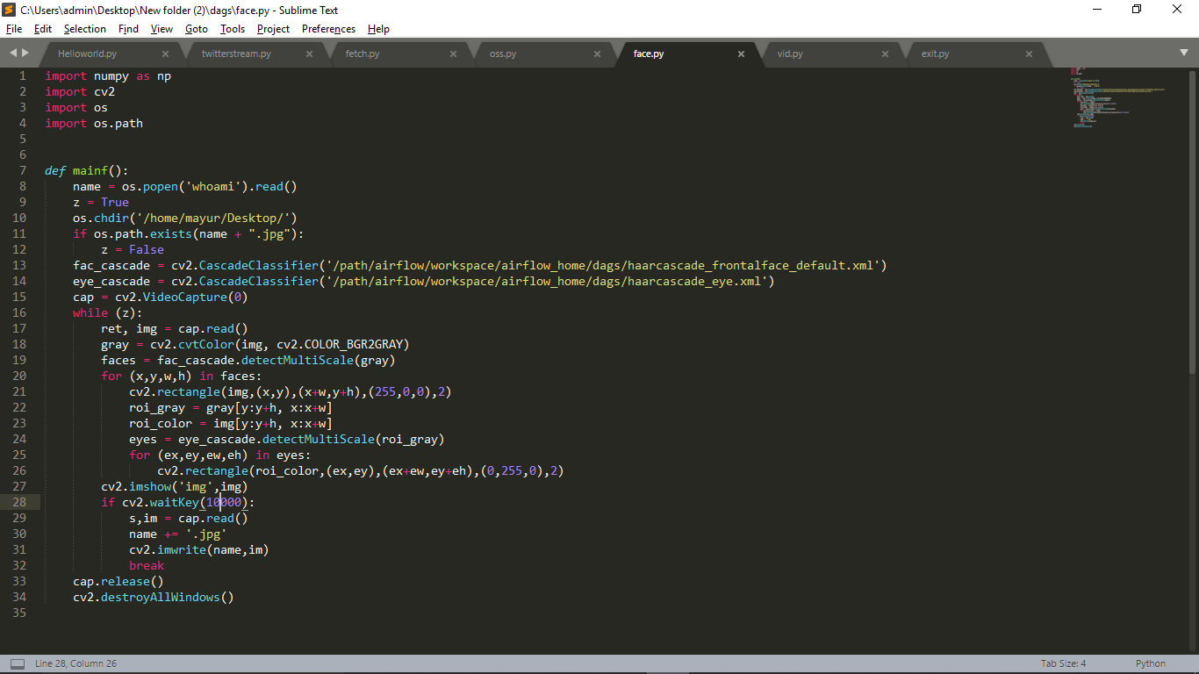
Path To harcascade_frontalface_default.xml
&
harcascade_eye.xml

Slide 27
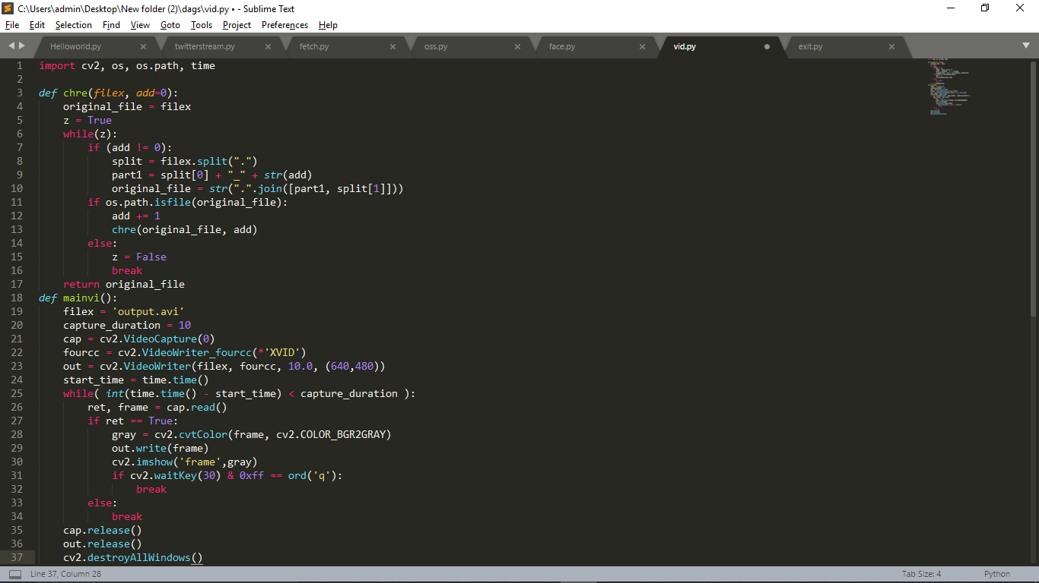

Slide 28
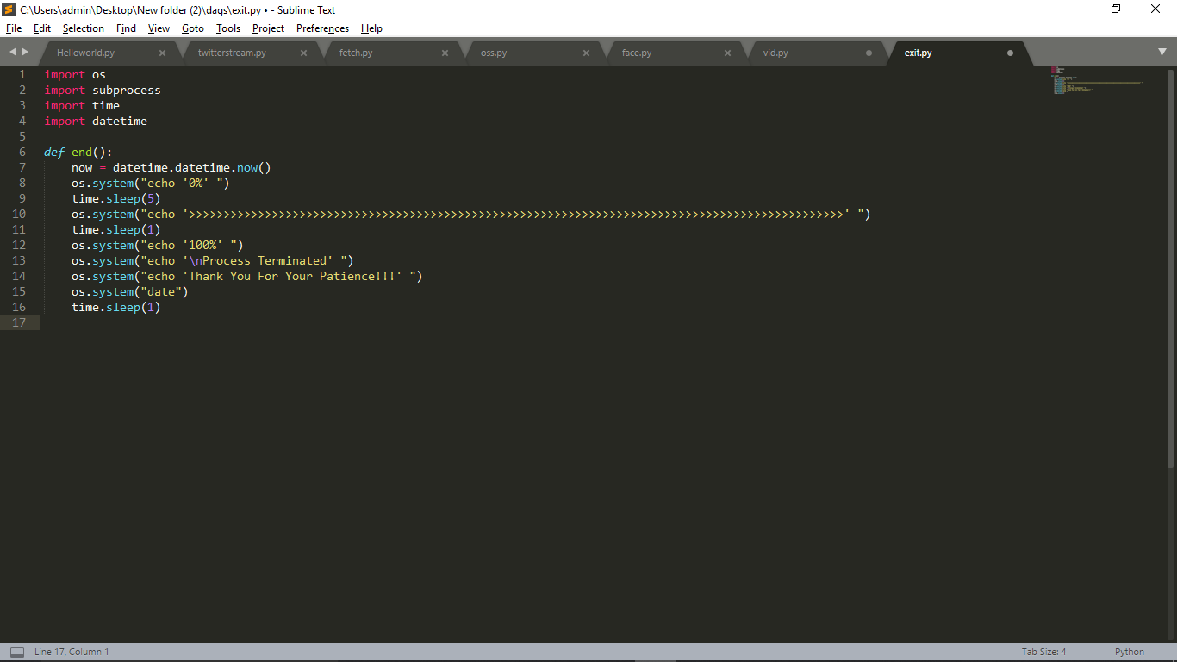

Slide 29
STEP 2. Project Based Learning Part B Steps To Run This Project
Initial Terminal >
sudo su cd <airflow workspace path> source venv/bin/activateexport AIRFLOW_HOME=<airflow workspace path>/airflow_home airflow initdb airflow webserver In Another Terminal >
sudo su cd <airflow workspace path> source venv/bin/activate export AIRFLOW_HOME=<airflow workspace path>/airflow_home airflow scheduler

Slide 30

Output To This Project

Slide 31
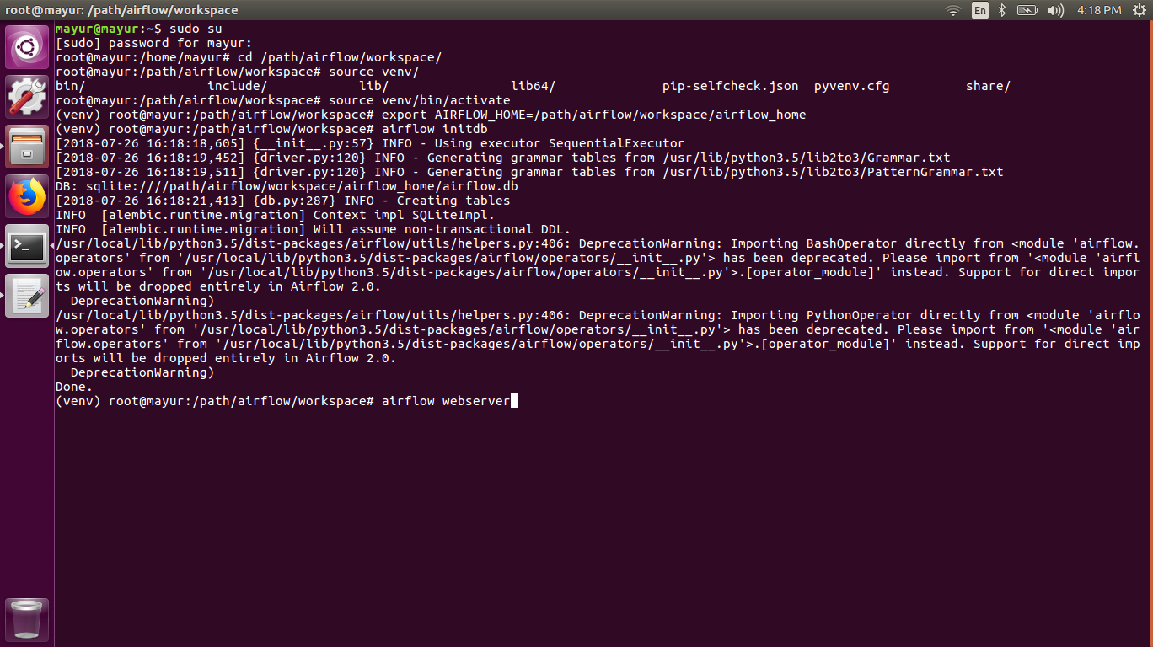

Slide 32
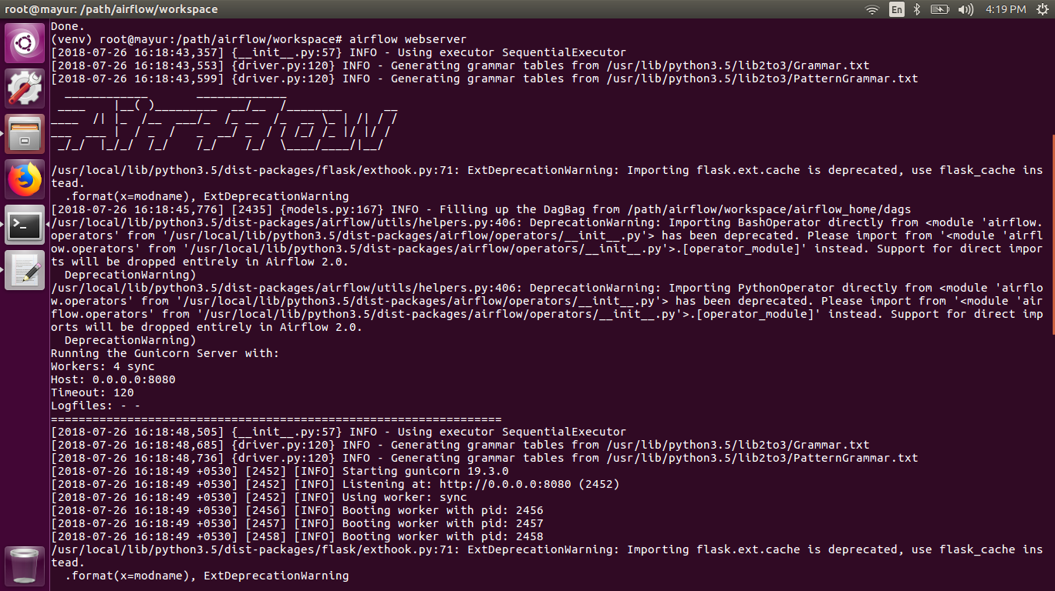

Slide 33
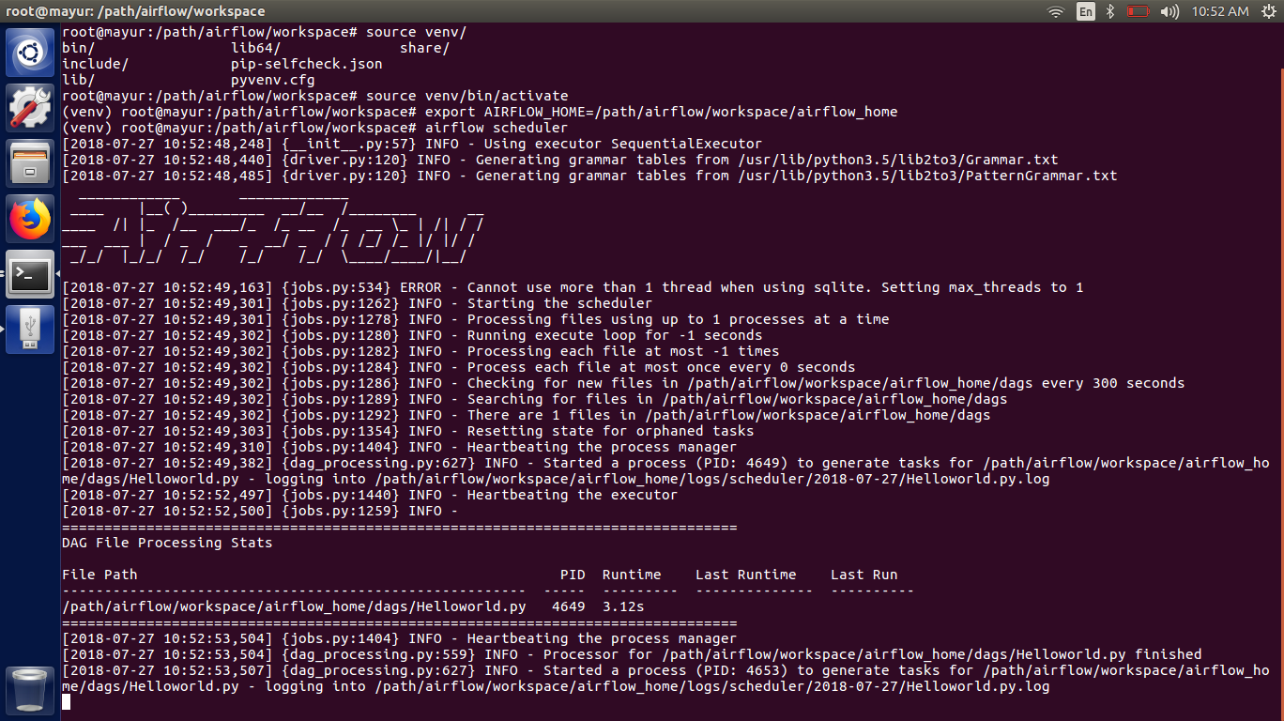

Slide 34
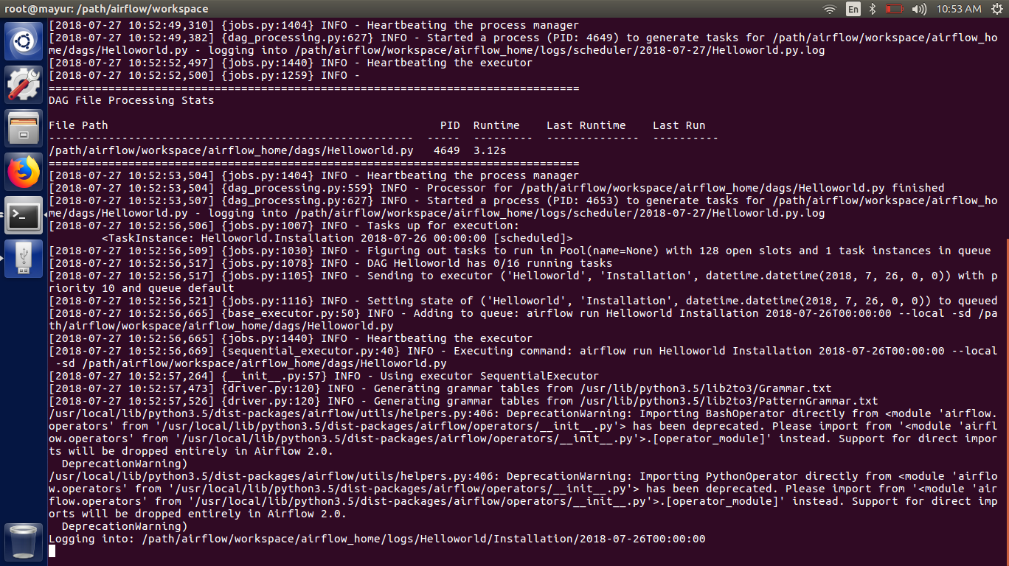

Slide 35
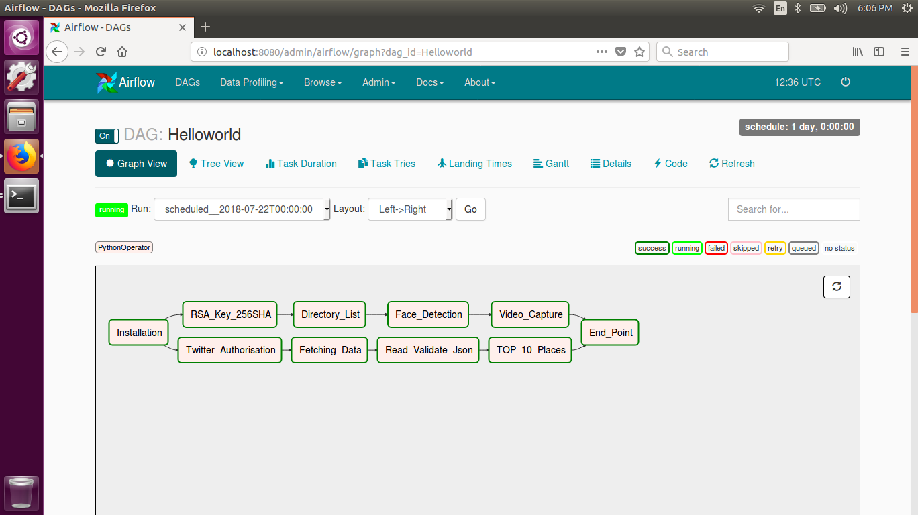

Slide 36
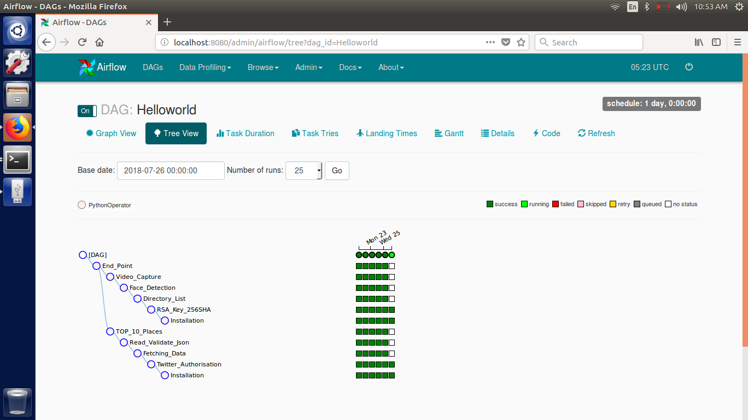

Slide 37
